Slide 2
Visiting BRIC: A Social Narrative
to hold a we
Sept. 19 - Dec. 22, 2024

Slide 3
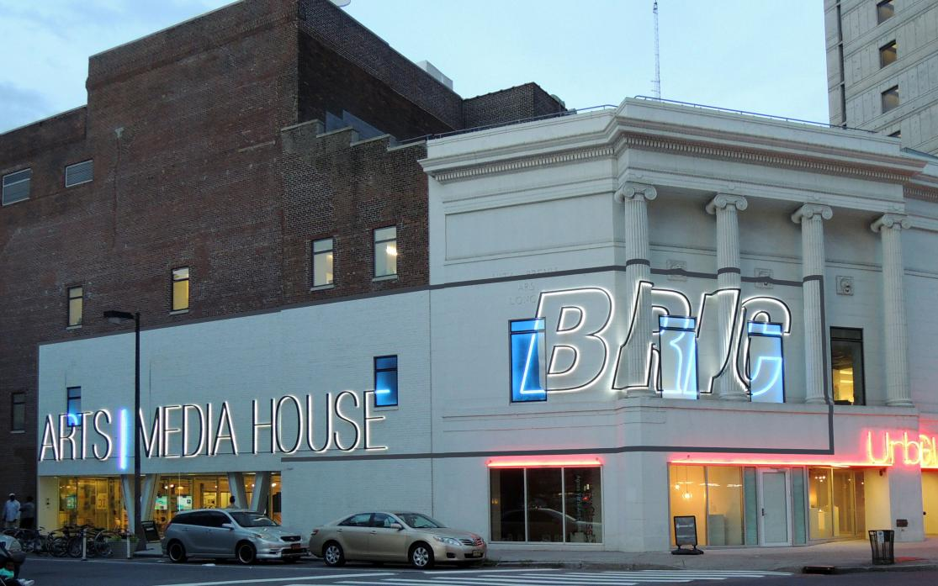
Welcome
I am going to BRIC House to experience the exhibition to hold a we.
The exhibition is open from September 19 - December 22, 2024, Tues-Sun, 11:00-6:00 PM.
The opening reception is on September 18 from 7:00 - 9:00 PM.
I can visit BRIC’s website to learn more about the exhibition.
Image description: A white stone and red brick building at dusk. Neon lights on the building spell out the words BRIC ARTS MEDIA HOUSE in all caps.

Slide 4
Preparing
Masks are required at the opening reception. If I don’t have a mask, BRIC can provide one.
BRIC will also provide:
Seating
A sensory friendly, low-stim room
A sensory kit with fidgets to play with
I can also bring my own noise-reducing headphones, earplugs, and/or fidgets.

Slide 5
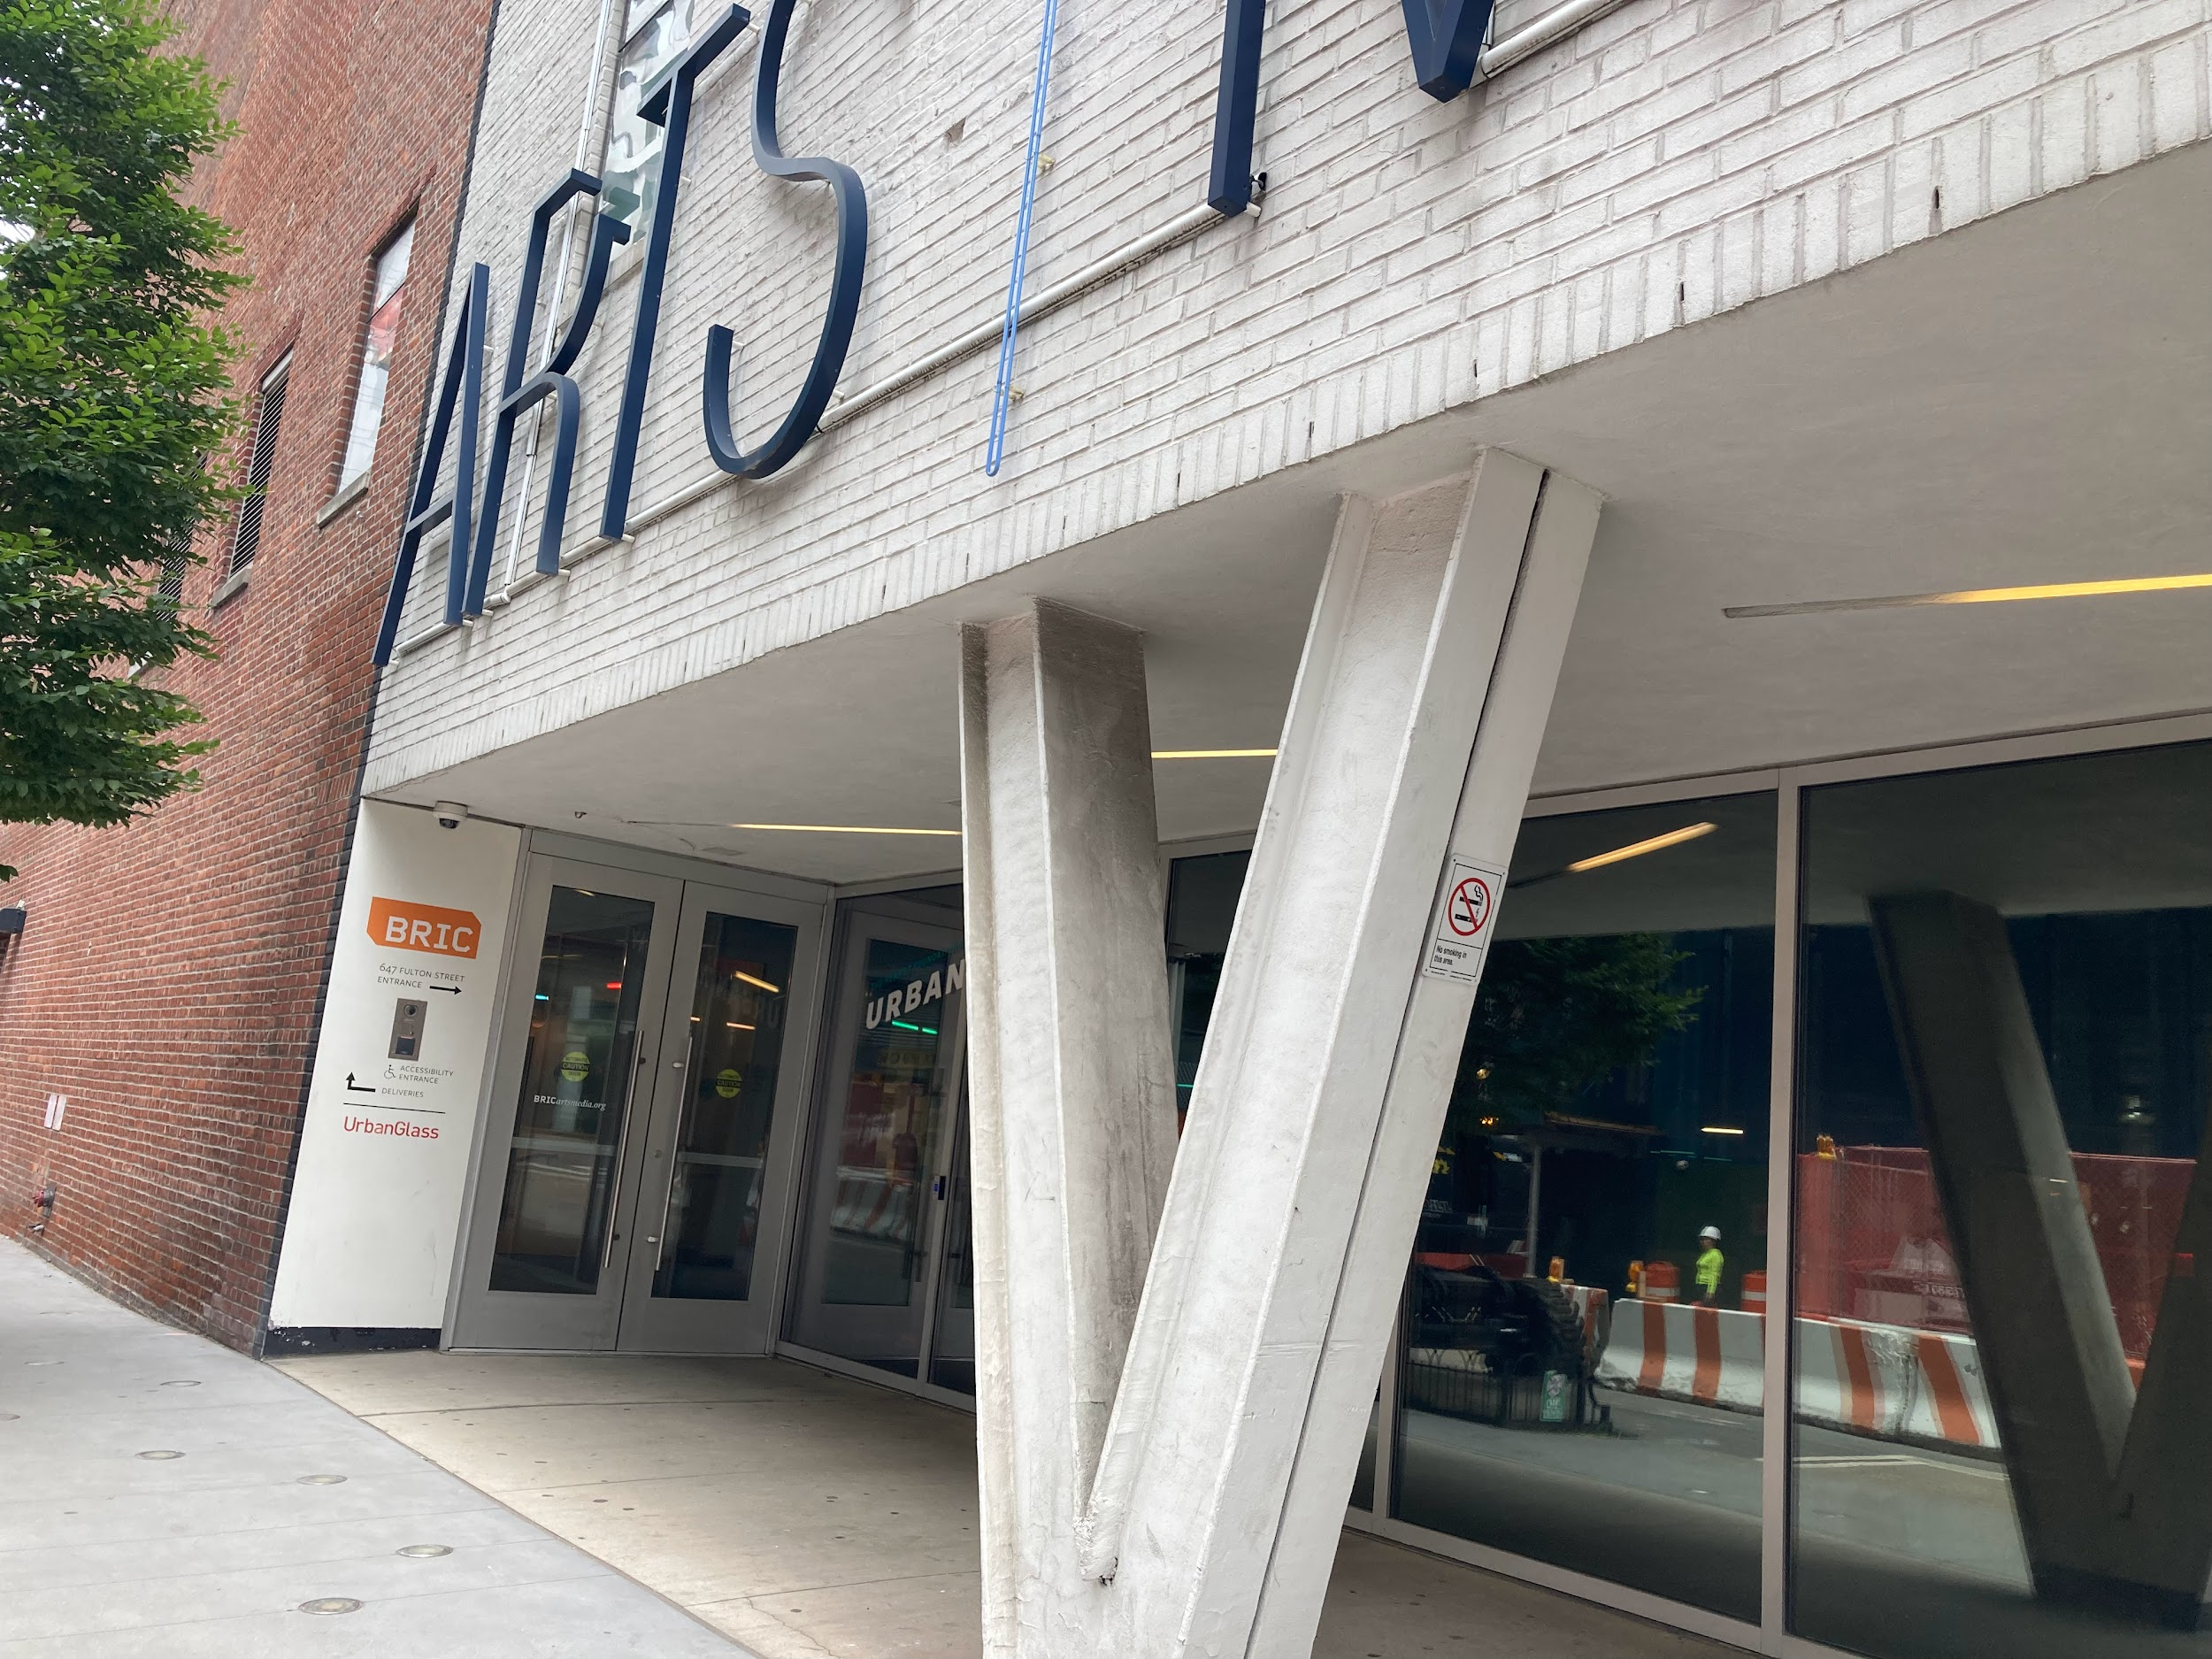
Arriving
I will arrive at BRIC, located at 647 Fulton Street. The main entrance is located on Rockwell Place. The main entrance is wheelchair accessible.
At the opening reception, there may be a line of people outside. I may need to wait a few minutes to enter the building.
There are many buildings under construction. I may notice a lot of noise and areas that are closed due to construction.
Image description: A white stone and red brick building with tinted windows. A sidewalk leads to two metallic doors.

Slide 6
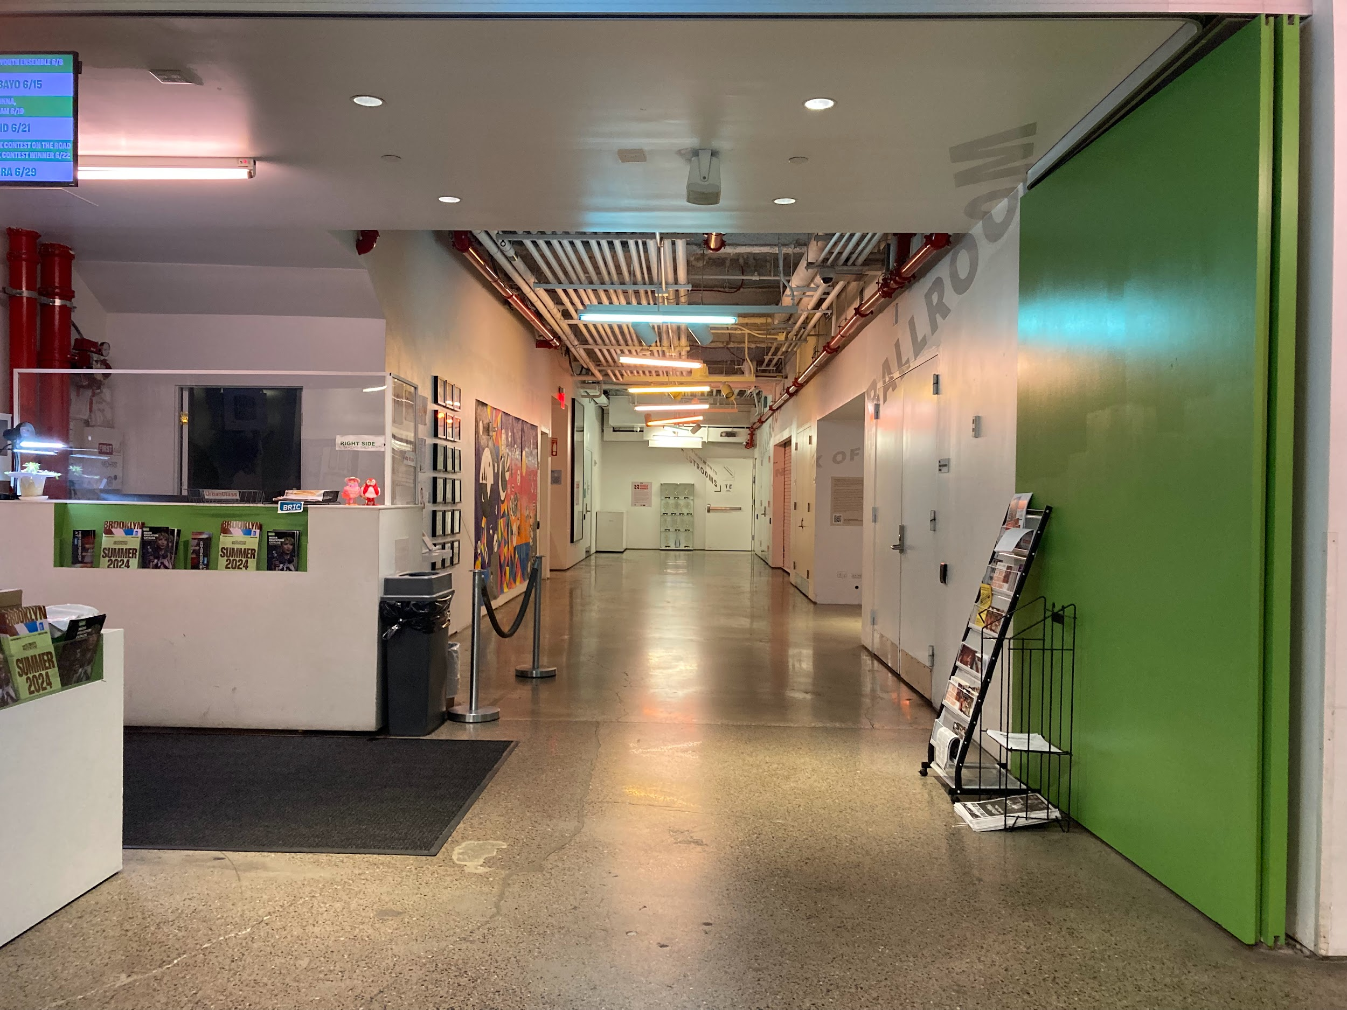
Checking in
When I enter BRIC House, a Visitor Experience Attendant will greet me.
Masks are required at the opening reception. If I do not have a mask, a Visitor Experience Attendant will provide one.
At the opening reception, the Visitor Experience Attendant may ask me for my name and check if I have RSVP'd. I will show them my ticket from my phone or device. They may scan my ticket.
Image description: A hallway with white and green walls, beige stone floors, and an exposed, industrial ceiling. On the left, a Security desk with program pamphlets.

Slide 7
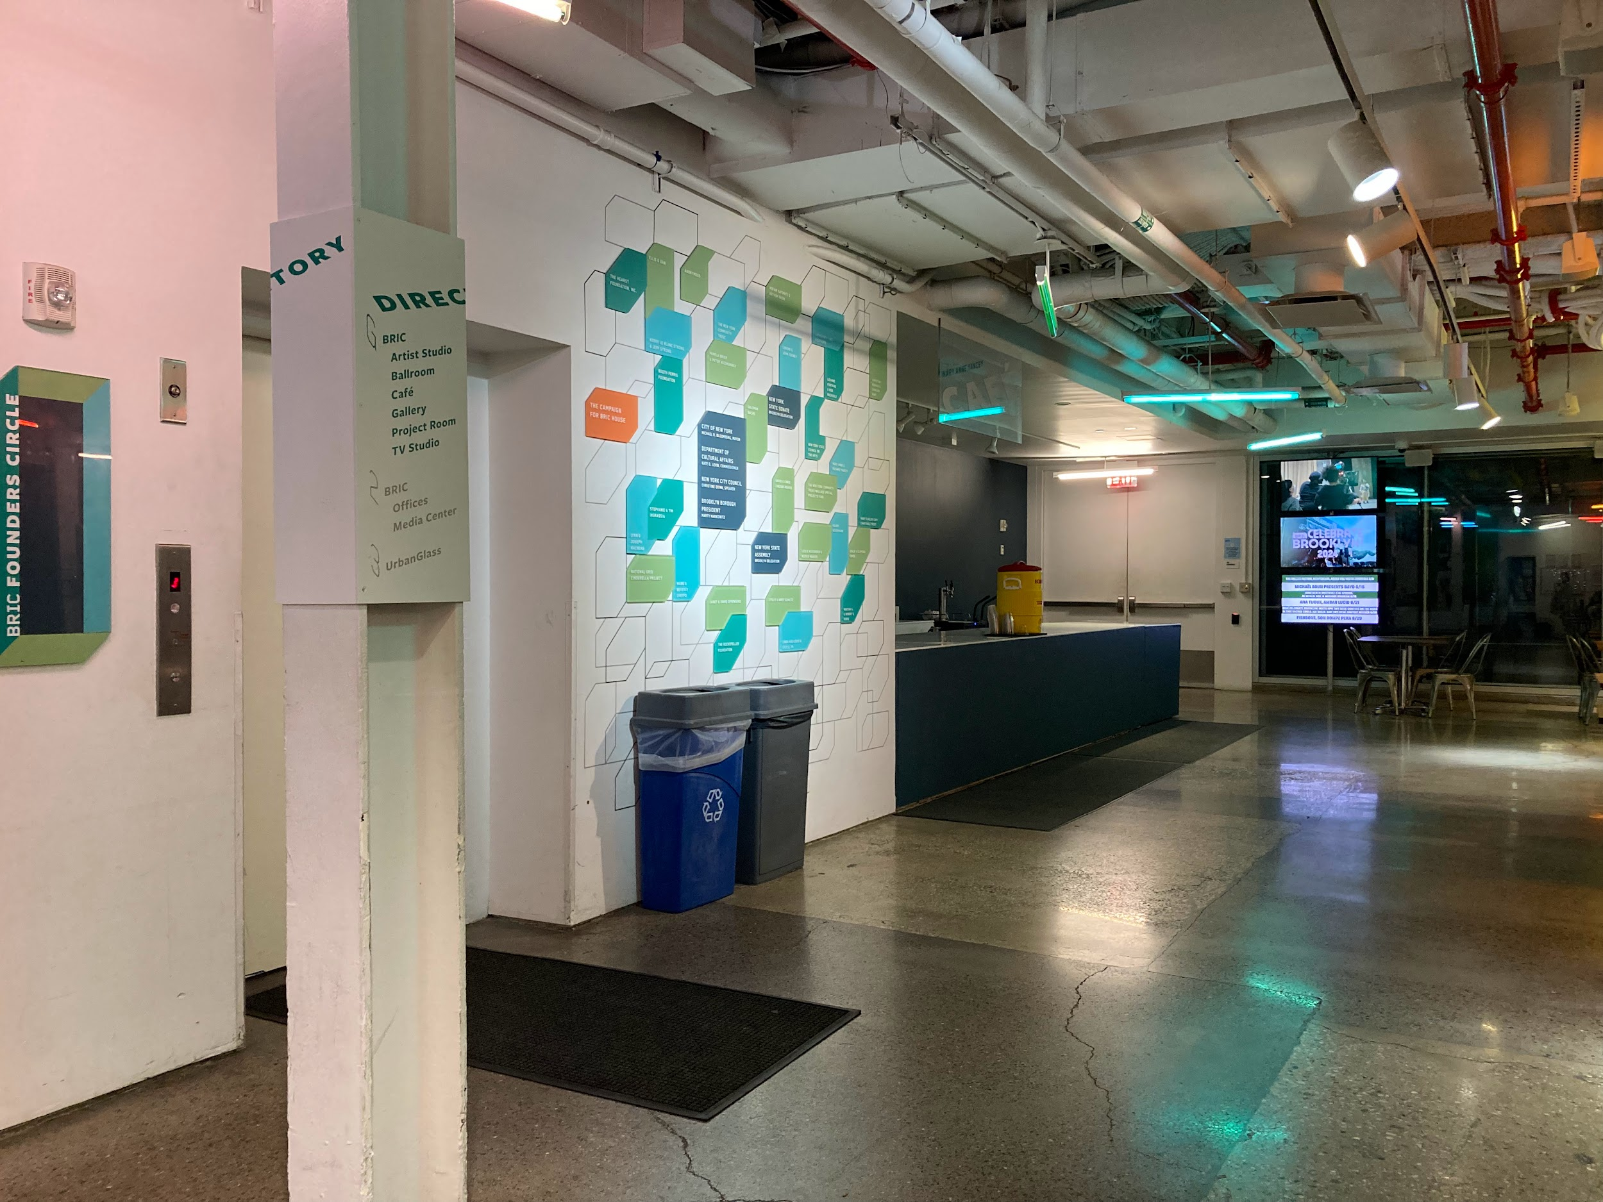
At BRIC
At the opening reception, I may notice a large crowd of people and lots of noises.
I can explore the Lobby, Cafe, Stoop, Gallery, and Project Room.
To explore the Gallery, I can take the stairs or I can ask a Visitor Experience Attendant to use the platform lift.
Image description: A lobby with stone floors and white walls. There is a white Directory sign with green and gray text on a white column that shares information about each floor. A white wall with green, teal, and orange rectangular placards with donor thanks. In the background, a Cafe counter, and monitors with digital advertisements about BRIC’s events and programs.

Slide 8
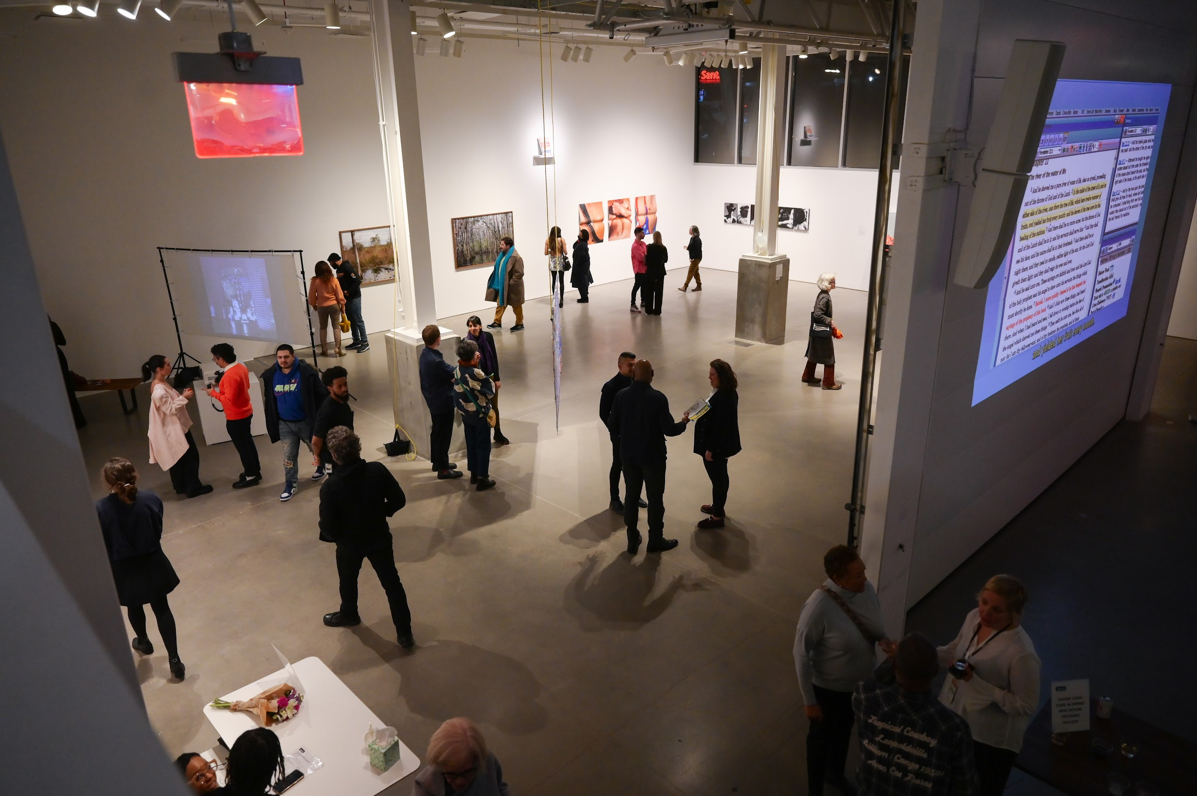
At BRIC
I can enjoy the artwork in the Gallery and Project Room. Some of the artwork is available to touch. There are signs indicating which artworks are available to touch. I can touch those specific works.
Food and drink are not allowed in the Gallery and Project Room. I can enjoy food and drink on the Lobby and Cafe.
Image description: A large white room, the Gallery, as seen from above. A red emergency exit sign hangs from the ceiling. Spotlights illuminate framed photographs on two walls. On the right, a video projection on a garage door. Twenty or so people explore the Gallery, admire the artwork, and engage in conversation with one another.

Slide 9
Taking a break
If I need to take a break or find a quiet space to rest during the opening reception, I can visit the sensory friendly low-stim room in the Artist Studio.
The Artist Studio is located down the North Hallway on the left side.
There are no steps to enter the Artist Studio.
Image description: A hallway with white and green walls, beige stone floors, and an exposed, industrial ceiling. On the left, a Security desk with program pamphlets.

Slide 10
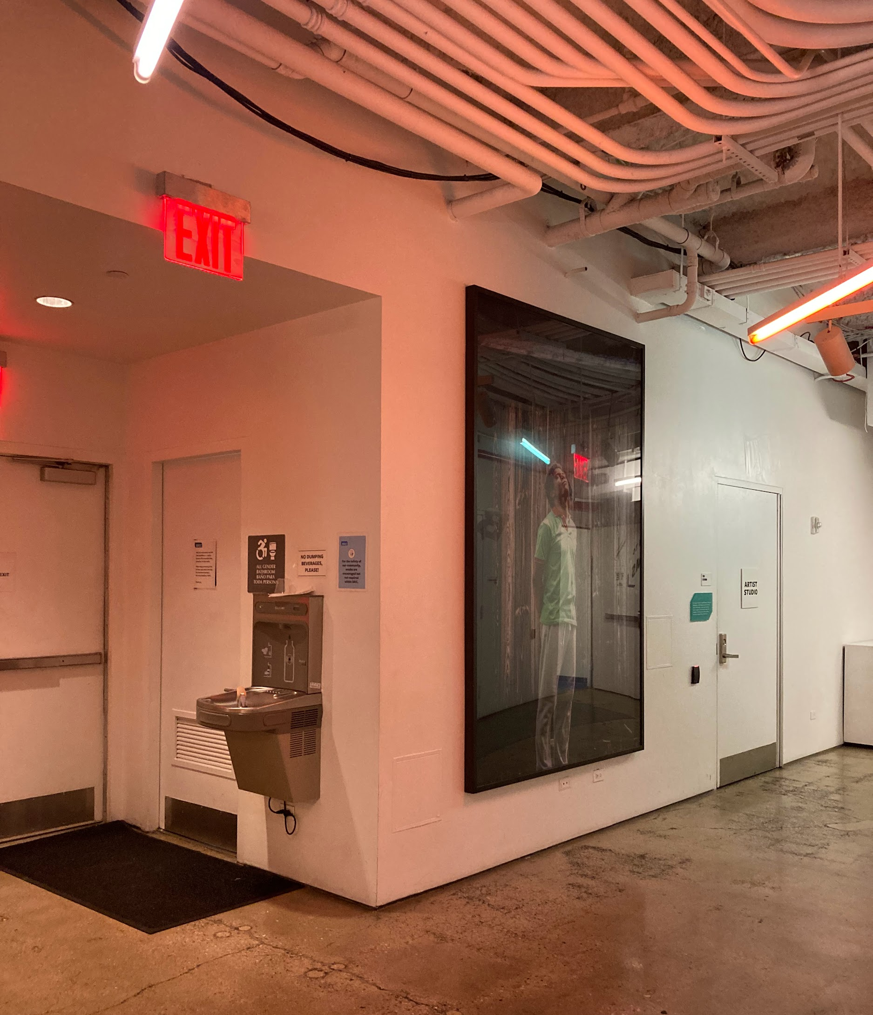
Taking a break
In the Artist Studio:
Lights are dim
I can sit
I can experience Robin’s Garden, a video by Alex Dolores Salerno
I can explore and play with Alex Dolores Salerno’s sensory kit
I can borrow ear plugs, headphones, and fidget toys
Image description: Two passageways intersect. On the left, a wall-mounted water fountain lives next to a single-use restroom door and an emergency exit. At center, a large framed portrait of a Jean-Michel Basquiat wearing a green t-shirt and gray slacks. On the right, a white door labelled Artist Studio.

Slide 11
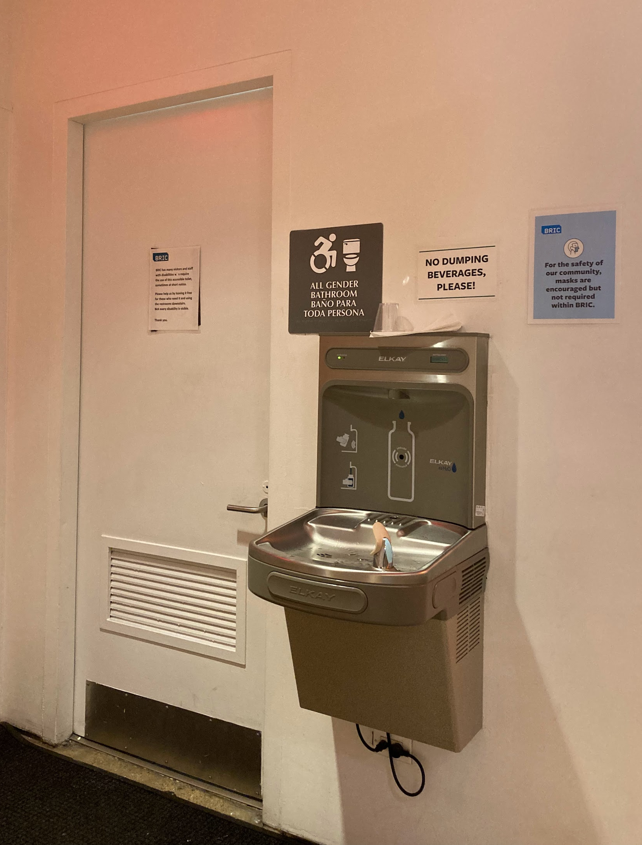
Restrooms and water fountains
There is an accessible, no-step, single use restroom on the main floor.
If I feel thirsty, I can use the water fountain next to this restroom.
There are additional men’s and women’s restrooms down a flight of stairs. These restrooms are only accessible by stairs.
Image description: A close-up image of a wall-mounted water fountain and refill station. A white sign above the water fountain reads in black, bold text “NO DUMPING BEVERAGES, PLEASE!” A blue sign encourages the use of masks. On the left, a white door leads to a single-use, all-gender restroom.

Slide 12
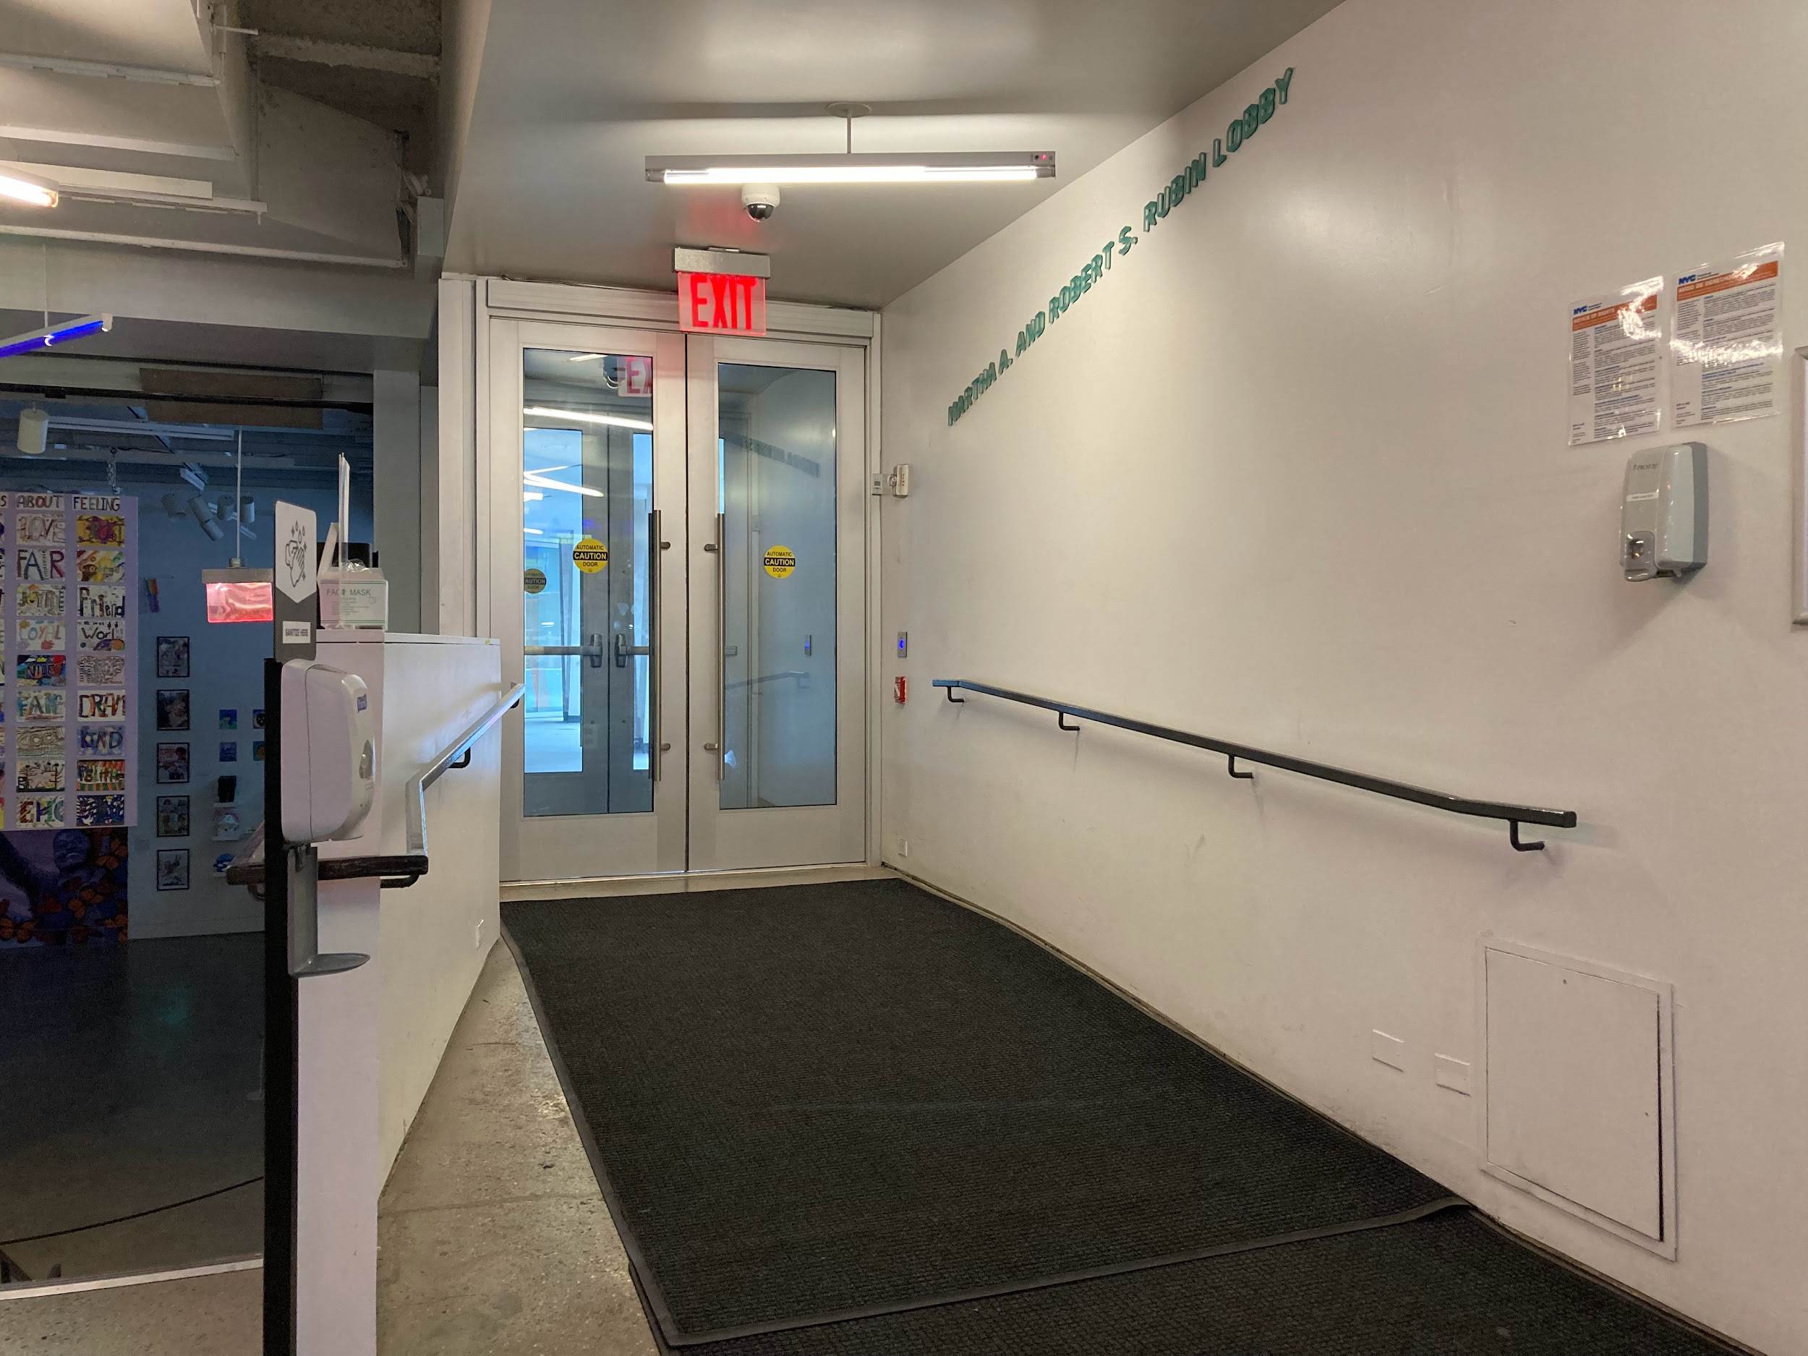
Leaving
The opening reception ends at 9:00 PM.
I will leave BRIC via the main entrance.
I can wave to open the accessible, power-assisted doors.
Image description: A ramped entryway with black floor rug and a black handrail on a white wall leads to two, glass, silver-framed, power-assisted doors. A red EXIT sign and white fluorescent tube illuminate the path.

