Slide 1
Visiting BRIC: A Social Narrative
shall we go together? A Symposium on Care, Equity, and Access in the Arts
December 7, 2024

Slide 2
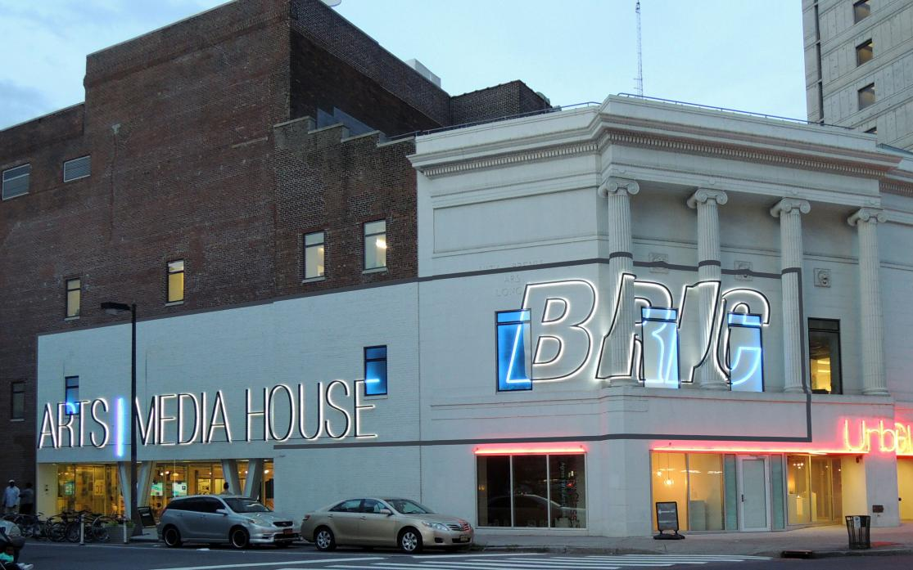
Welcome
I am going to BRIC House for shall we go together? A Symposium on Care, Equity, and Access in the Arts.
The event on Saturday, December 7, 2024 from 9:30 AM - 7:00 PM.
I can visit BRIC’s website to learn more about the event.
Image description: A white stone and red brick building at dusk. Neon lights on the building spell out the words BRIC ARTS MEDIA HOUSE in all caps.

Slide 3
Preparing
Masks are required at the event. If I don’t have a mask, BRIC can provide one.
BRIC will also provide:
Seating
CART real-time captioning for in-person activities
A sensory friendly, low-stim quiet room to take a break
A sensory kit with fidgets to play with
I can also bring my own noise-reducing headphones, earplugs, and/or fidgets.

Slide 4
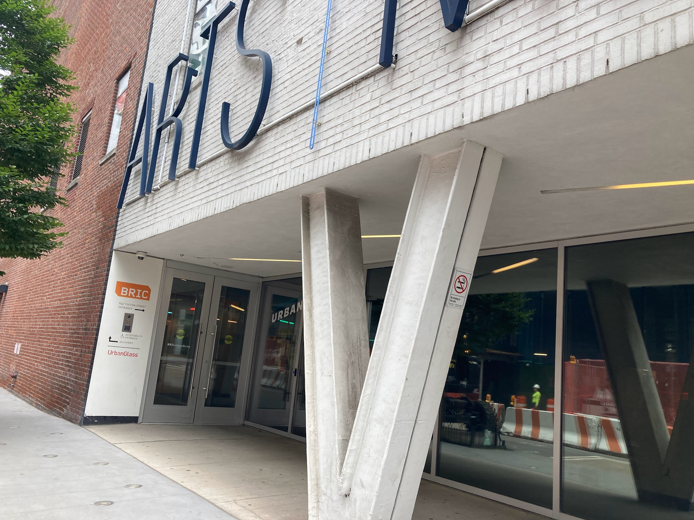
Arriving
I will arrive at BRIC House, located at 647 Fulton Street. The main entrance is located on Rockwell Place. The main entrance is wheelchair accessible.
At the symposium, there may be a line of people outside. I may need to wait a few minutes to enter the building.
There are many buildings under construction. I may notice a lot of noise and areas that are closed due to construction.
Image description: A white stone and red brick building with tinted windows. A sidewalk leads to two metallic doors.

Slide 5
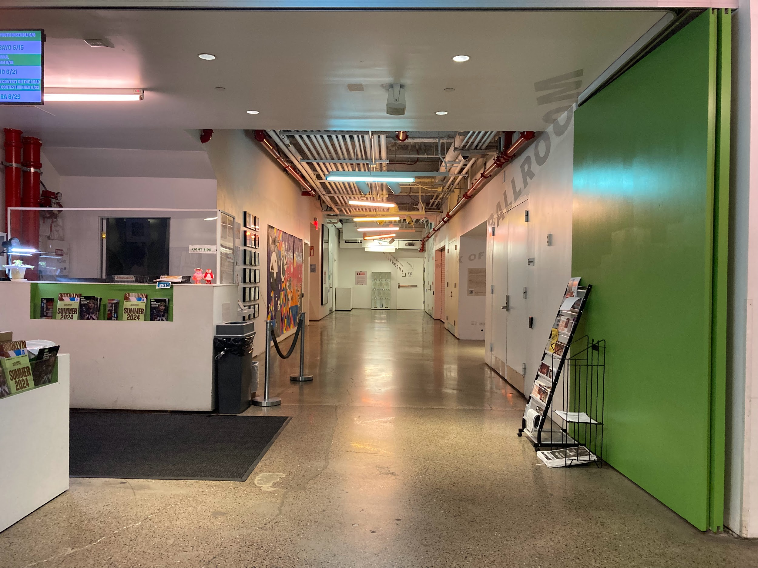
Checking in
When I enter BRIC House, a Visitor Experience Attendant will greet me.
Masks are required at the event. If I do not have a mask, a Visitor Experience Attendant will provide one.
At the event, the Visitor Experience Attendant may ask me for my name and check if I have RSVP'd. I will show them my ticket from my phone or device. They may scan my ticket.
I can leave my coat or bag at coat check.
Image description: A hallway with white and green walls, beige stone floors, and an exposed, industrial ceiling. On the left, a Security desk with program pamphlets.

Slide 6
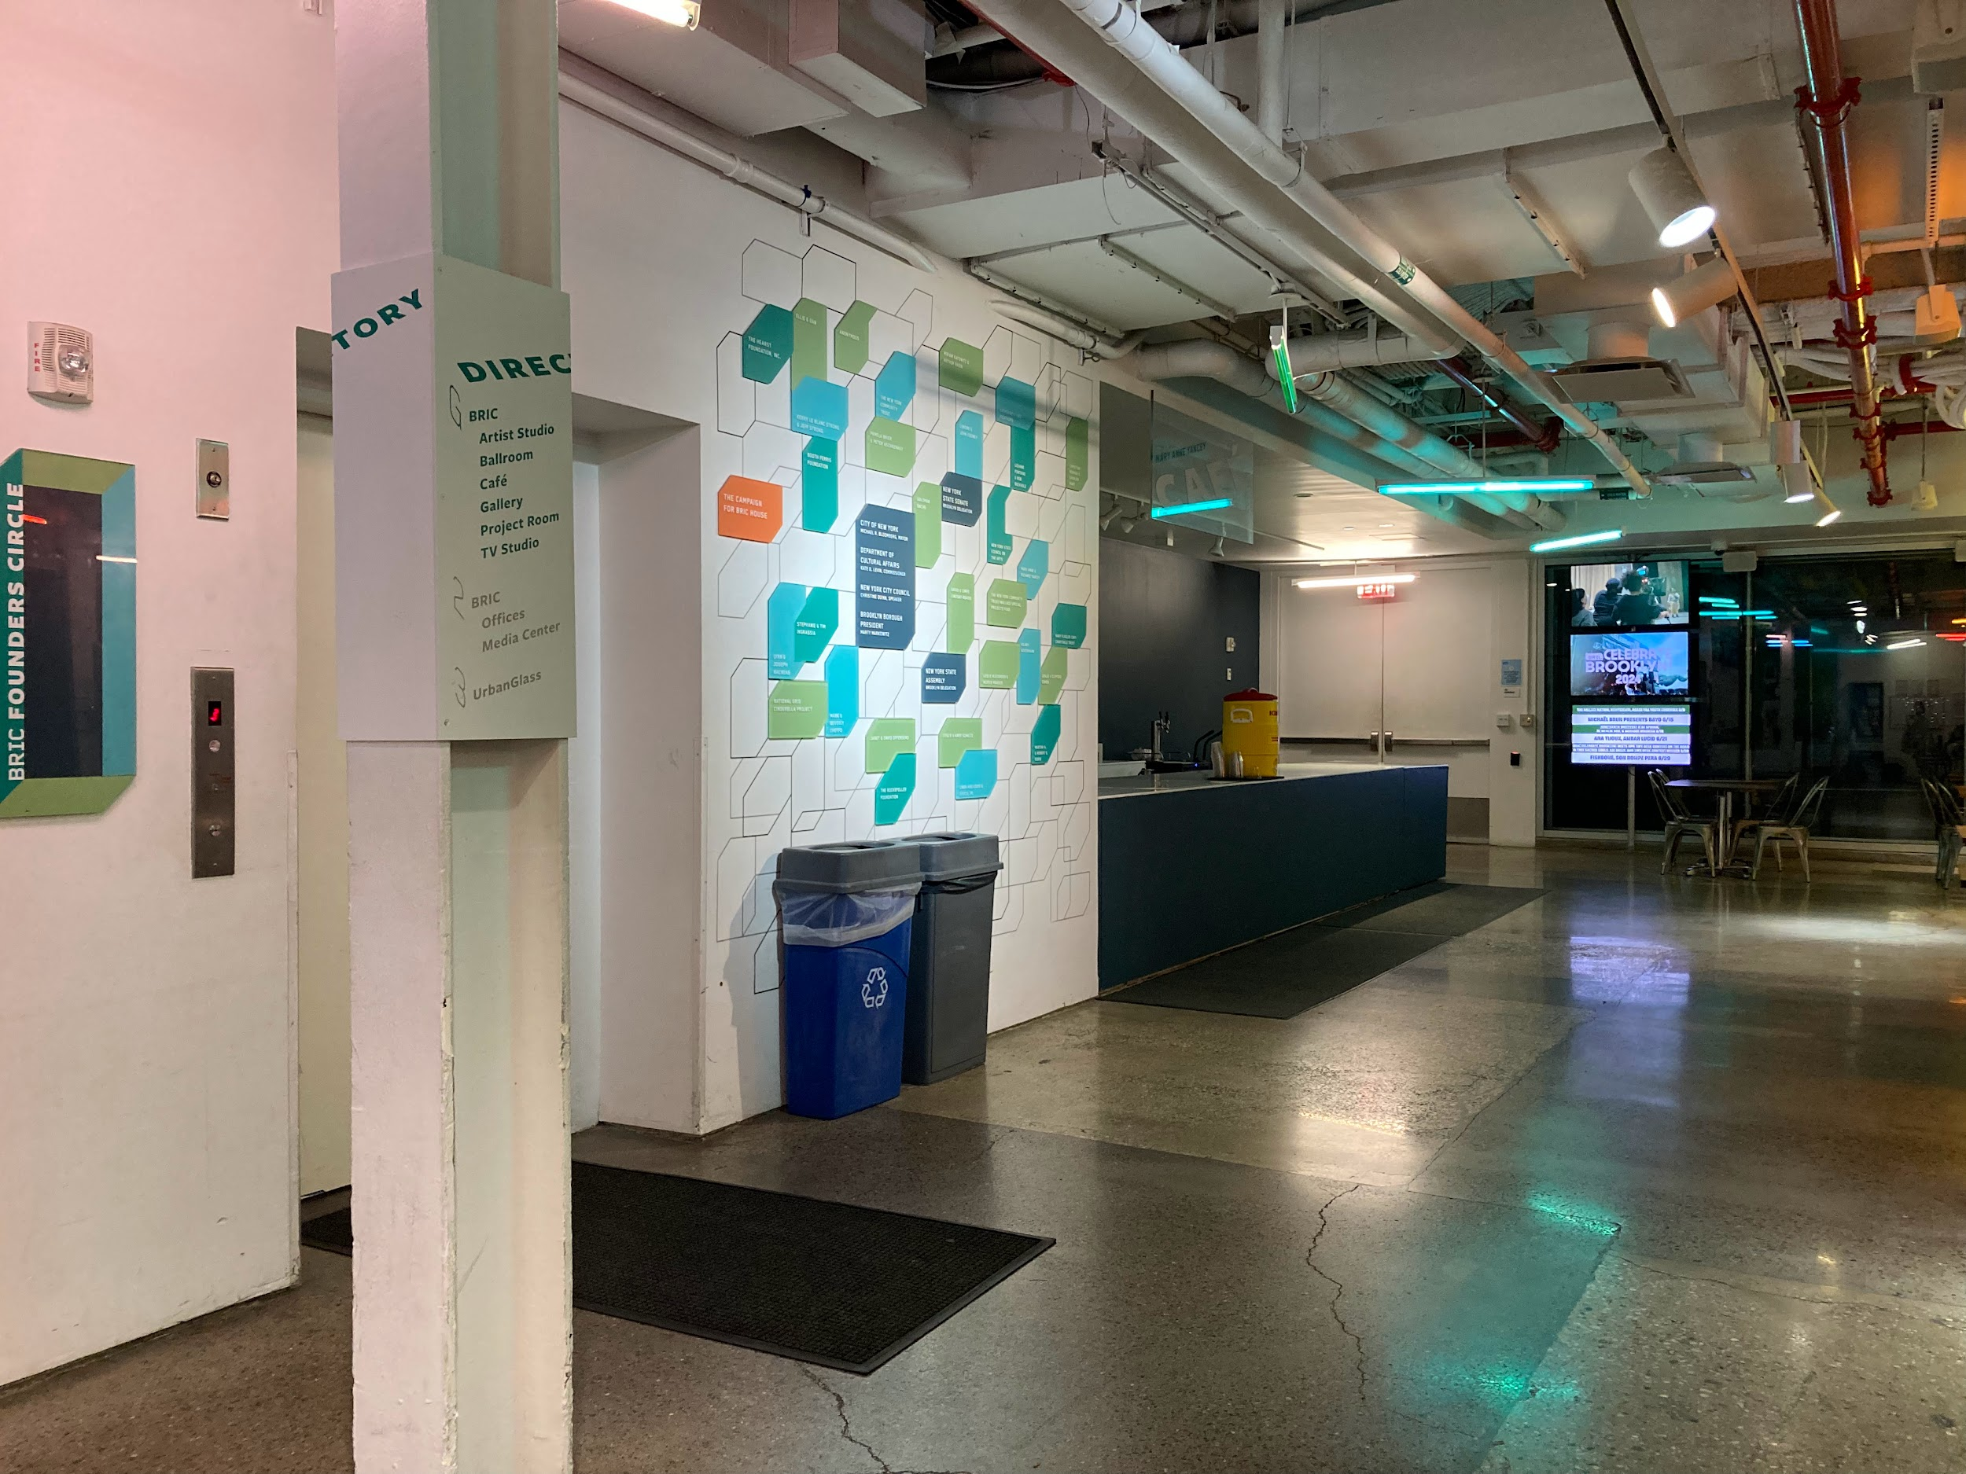
At BRIC
At the event, I may notice a large crowd of people and lots of noises.
I can explore the Ballroom, Lobby, Cafe, Stoop, Gallery, and Project Room.
To explore the Gallery, I can take the stairs or I can ask a Visitor Experience Attendant to use the platform lift.
Image description: A lobby with stone floors and white walls. There is a white Directory sign with green and gray text on a white column that shares information about each floor. A white wall with green, teal, and orange rectangular placards with donor thanks. In the background, a Cafe counter, and monitors with digital advertisements about BRIC’s events and programs.

Slide 7
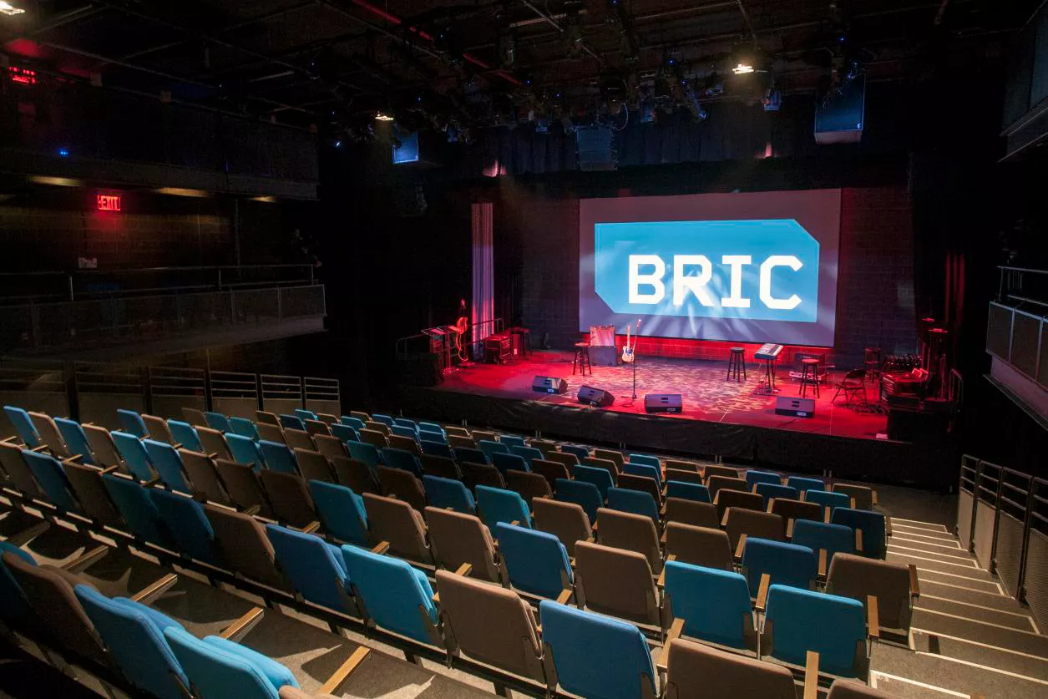
At BRIC
I can enjoy the programs in the Ballroom. These programs include a fishbowl discussion, artist-led workshops, and music. There are no steps to enter the Ballroom.
There is seating available for me to sit. Depending on the program, I may choose to sit or stand.
Food and drink are not allowed in the Ballroom. I can enjoy food and drink in the Lobby and Cafe.
Image description: A large dark room, the Ballroom, as seen from above. A seating bank with gray and teal seats extends towards a stage. On the stage, illuminated by red spotlights, there are speakers, musical instruments, and microphones set up. BRIC’s green and white logo is projected onto a screen.

Slide 8
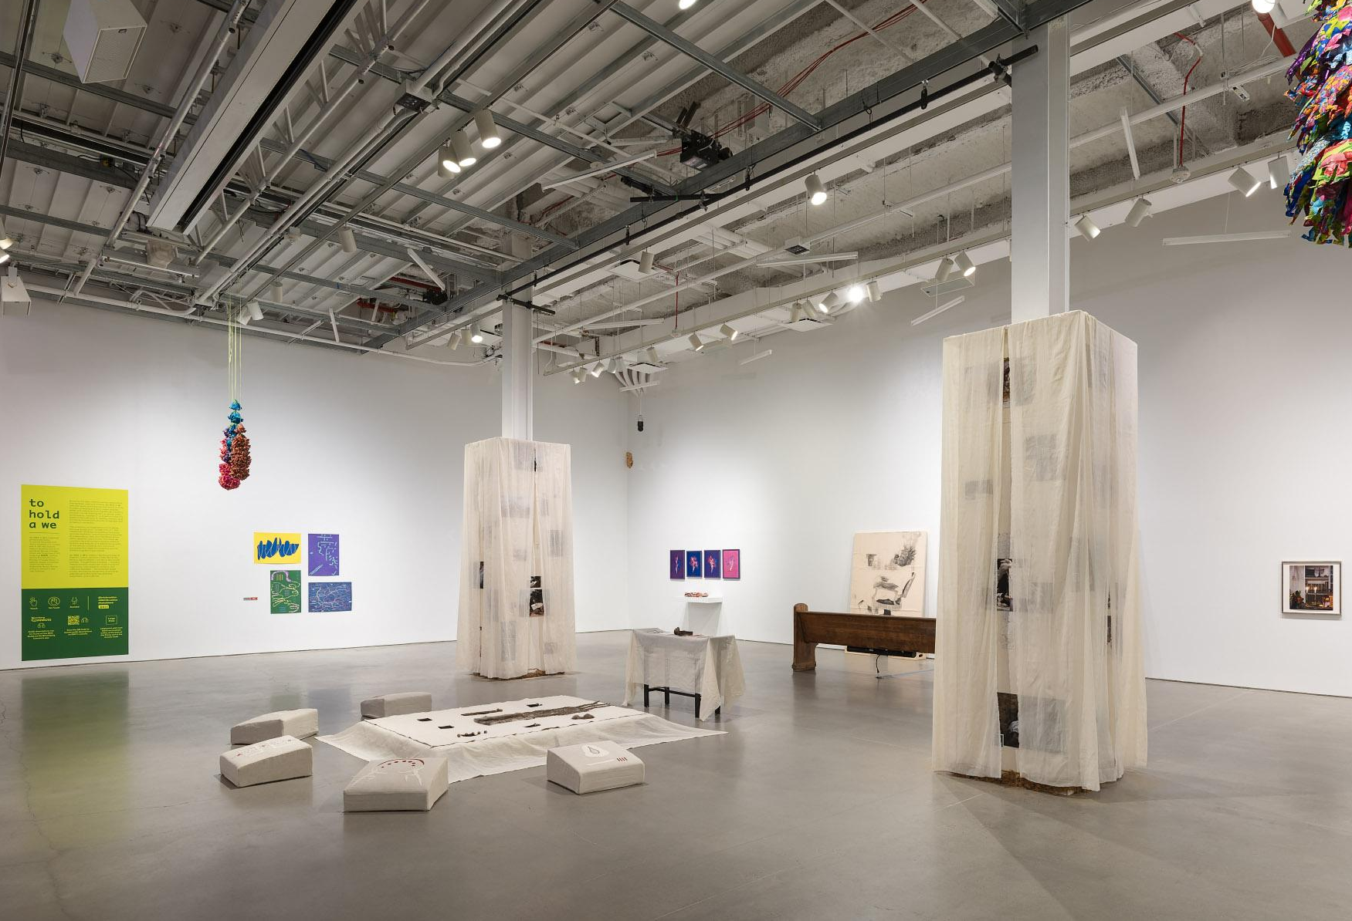
At BRIC
I can enjoy the artwork in the Gallery and Project Room. The exhibition is titled to hold a we. Some of the artwork is available to touch. There are signs indicating which artworks are available to touch. I can touch those specific works.
Food and drink are not allowed in the Gallery and Project Room. I can enjoy food and drink in the Lobby and Cafe.
Image description: An exhibition in a large white room known as the Gallery. Spotlights illuminate artworks arranged on the floor, on the walls, and hung from the ceiling.

Slide 9
Morning Schedule
9:30-10:30 AM | I can arrive at BRIC to enjoy free coffee, tea, and light breakfast foods in the Cafe.
10:30-11:30 AM | I can join the Artist & Curator Exhibition Tour in the Gallery.
11:30-11:45 AM | I can take a break in the Cafe, Quiet Room, or outside of BRIC.
11:45-1:00 PM | I can experience the Fishbowl Discussion with artists and writers in the Ballroom.
1:00-2:00 PM | I can eat lunch in the Cafe or outside of BRIC.

Slide 10
Afternoon Schedule
2:00-3:30 PM | I can learn more about Access Riders in the Ballroom or practice writing in the Gallery.
3:30-3:45 PM | I can take a break.
3:45-5:15 PM | I can participate in the movement workshop in the Ballroom or draw in the Gallery.
5:15-5:30 PM | I can take a break in the Cafe, Quiet Room, or outside of BRIC.
5:30-7:00 PM | I can enjoy the music during Remote Access Party in the Ballroom.

Slide 11
Taking a break
If I need to take a break or find a quiet space to rest during the event, I can visit the sensory friendly low-stim room in the Artist Studio.
The Artist Studio is located down the North Hallway on the left side.
There are no steps to enter the Artist Studio.
Image description: A hallway with white and green walls, beige stone floors, and an exposed, industrial ceiling. On the left, a Security desk with program pamphlets.

Slide 12
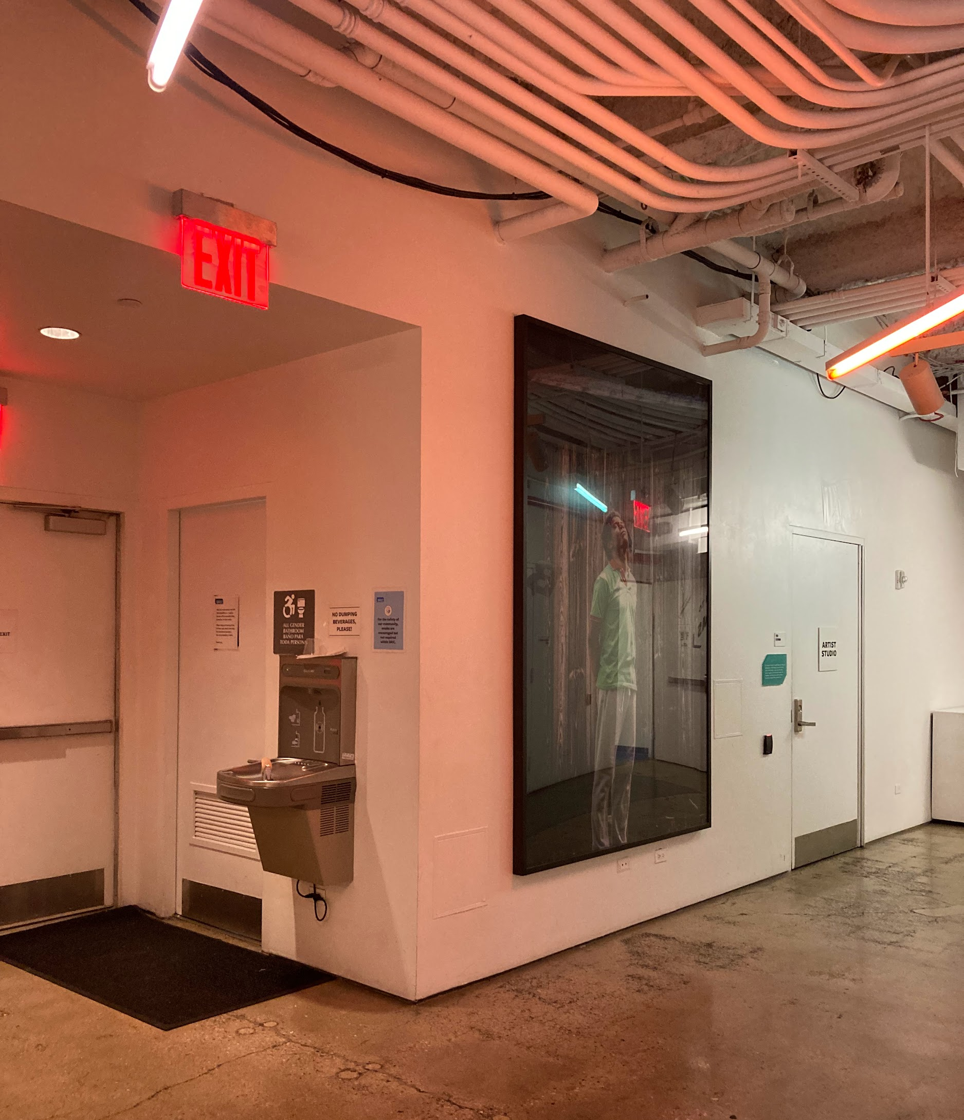
Taking a break
In the Artist Studio:
Lights are dim
I can sit
I can experience Robin’s Garden, a video by Alex Dolores Salerno
I can explore and play with Alex Dolores Salerno’s sensory kit
I can borrow ear plugs, headphones, and fidget toys
I can color pages from Dominic Bradley’s adult coloring book, their wildest dreams
Image description: Two passageways intersect. On the left, a wall-mounted water fountain lives next to a single-use restroom door and an emergency exit. At center, a large framed portrait of a Jean-Michel Basquiat wearing a green t-shirt and gray slacks. On the right, a white door labelled Artist Studio.

Slide 13
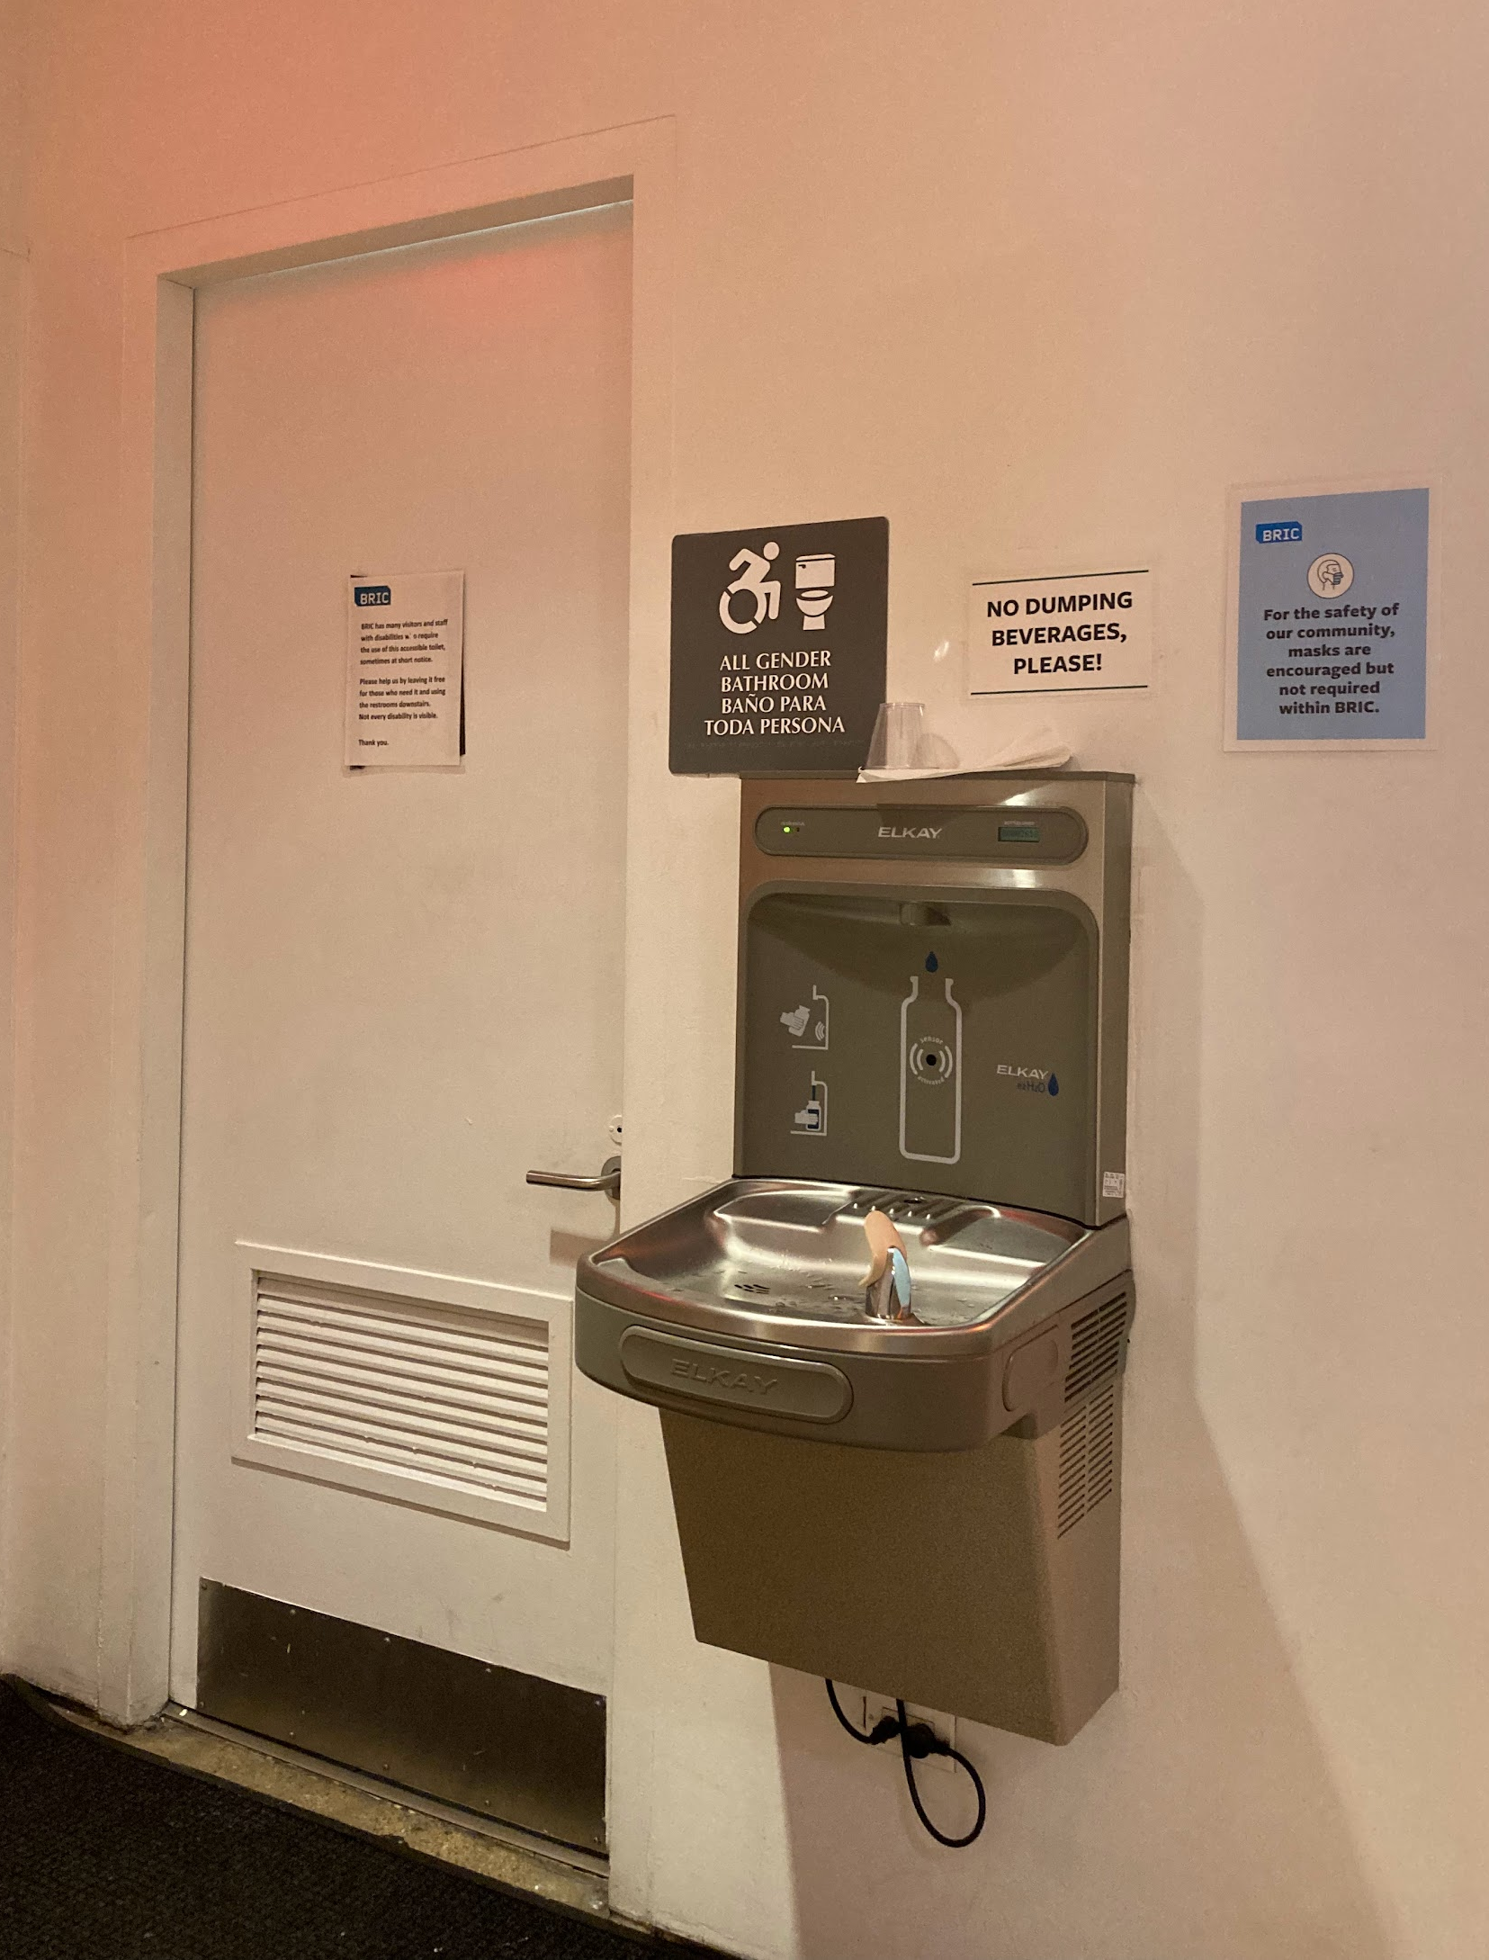
Restrooms and water fountains
There is an accessible, no-step, single use restroom on the main floor.
If I feel thirsty, I can use the water fountain next to this restroom.
There are additional men’s and women’s restrooms down a flight of stairs. These restrooms are only accessible by stairs.
Image description: A close-up image of a wall-mounted water fountain and refill station. A white sign above the water fountain reads in black, bold text “NO DUMPING BEVERAGES, PLEASE!” A blue sign encourages the use of masks. On the left, a white door leads to a single-use, all-gender restroom.

Slide 14
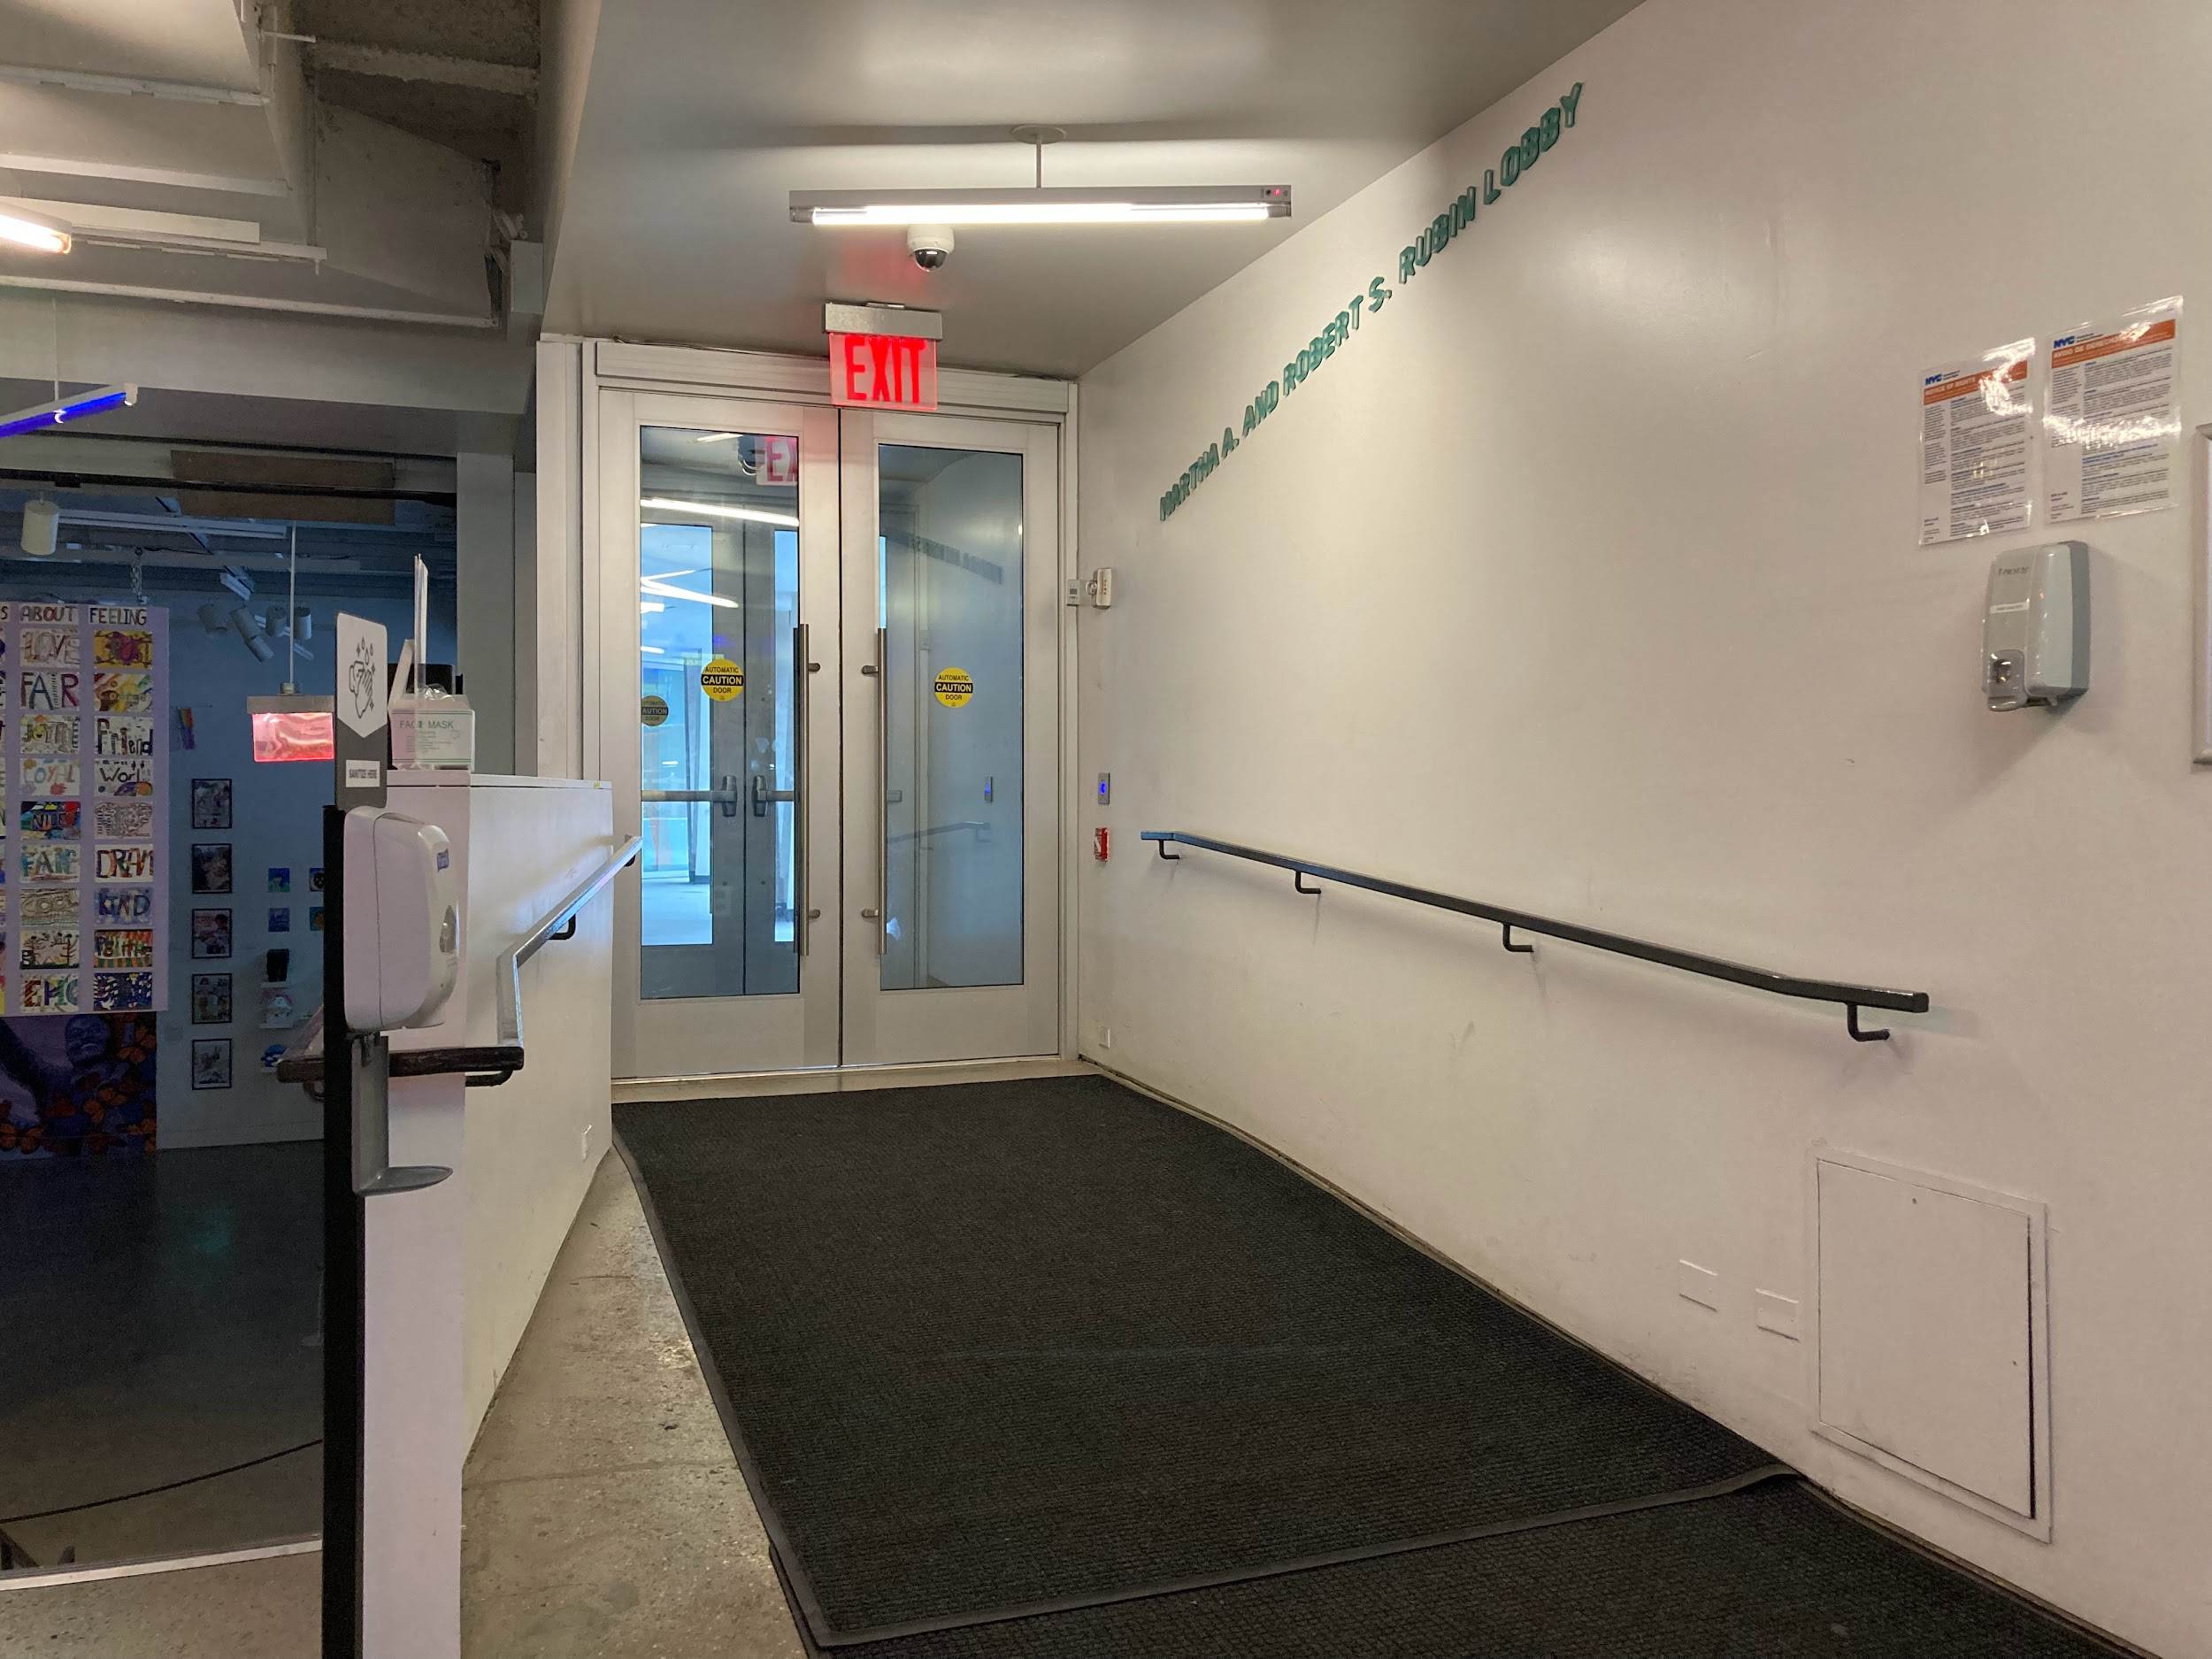
Leaving
The event ends at 7:00 PM.
I will leave BRIC via the main entrance.
I can wave to open the accessible, power-assisted doors.
Image description: A ramped entryway with black floor rug and a black handrail on a white wall leads to two, glass, silver-framed, power-assisted doors. A red EXIT sign and white fluorescent tube illuminate the path.

